Slide 1
你要做什么抉择？
What Decision Do You Make?
约翰福音
John 6:60-71
赖敏超传道

Slide 2
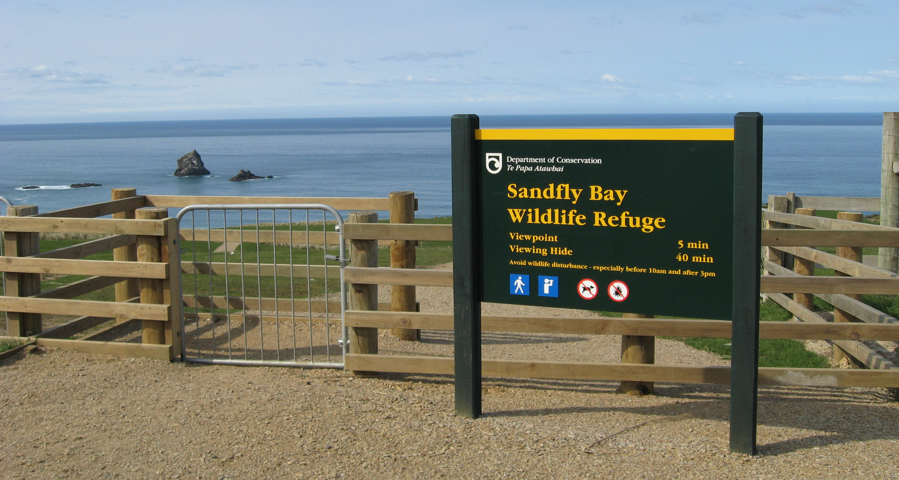
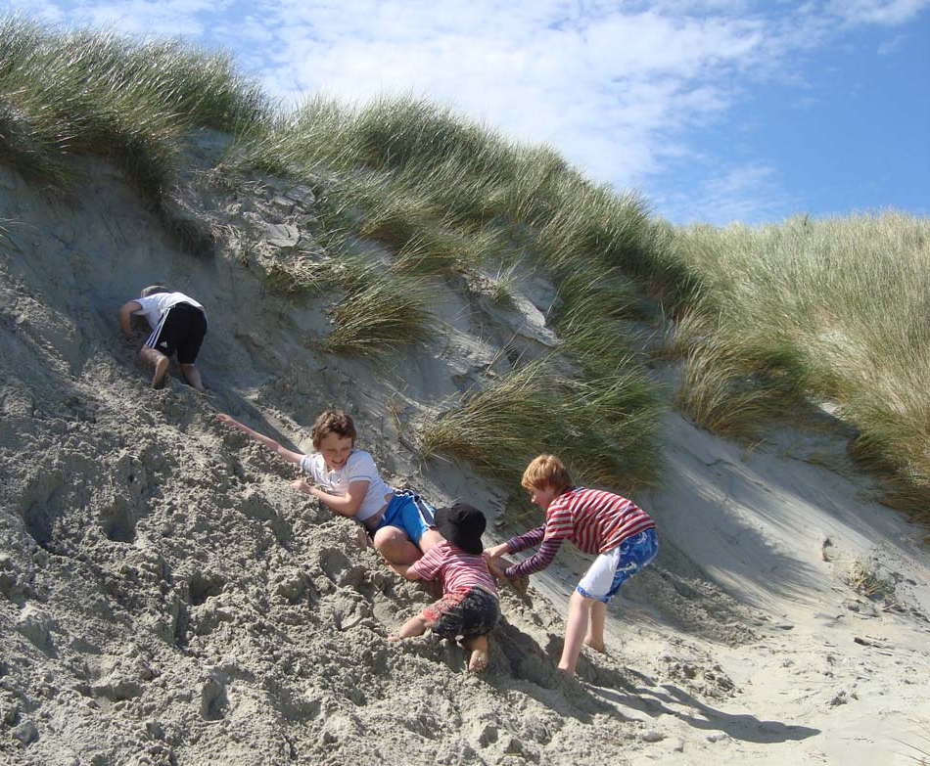
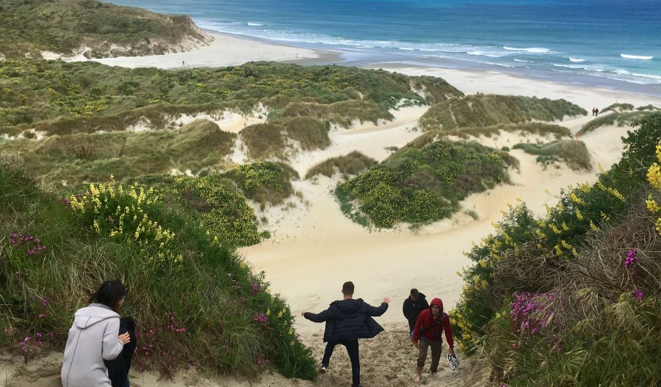
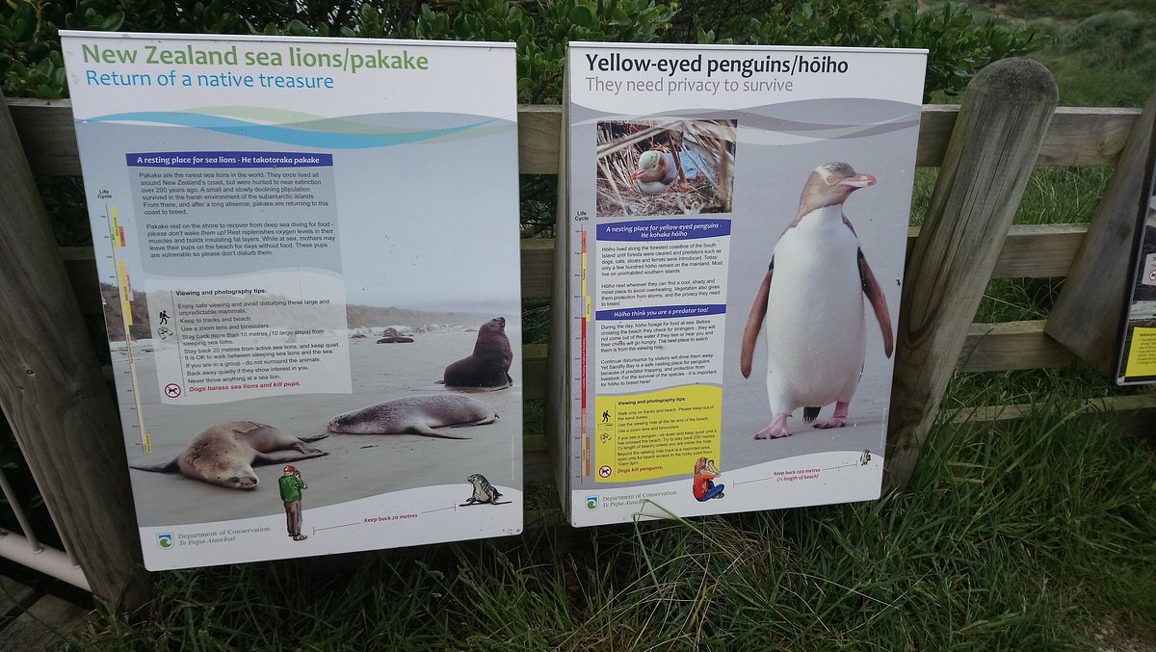
纽
西
兰
探
险

Slide 3
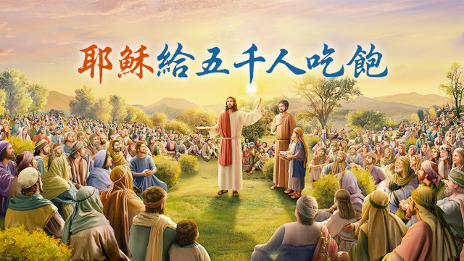
上个主日的信息
Last Sunday’s message

Slide 4
一。不忠背弃者 Defection (v 60-66, 70-71)
逃兵、半途而退者 Deserters
骗子、鱼目混珠者 Deceiver
二。坚定跟随者 Determination (v 67-69)

Slide 5
一。不忠背弃者 Defection (v 60-66, 70-71)
逃兵、半途而退者 Deserters (v 60-66)
难以接受耶稣的话 (v 60)
退去不再和祂同行 (v 66)
“hard”: not hard to understand, but unacceptable, harsh or offensive

Slide 6
Bandwagon

Slide 7
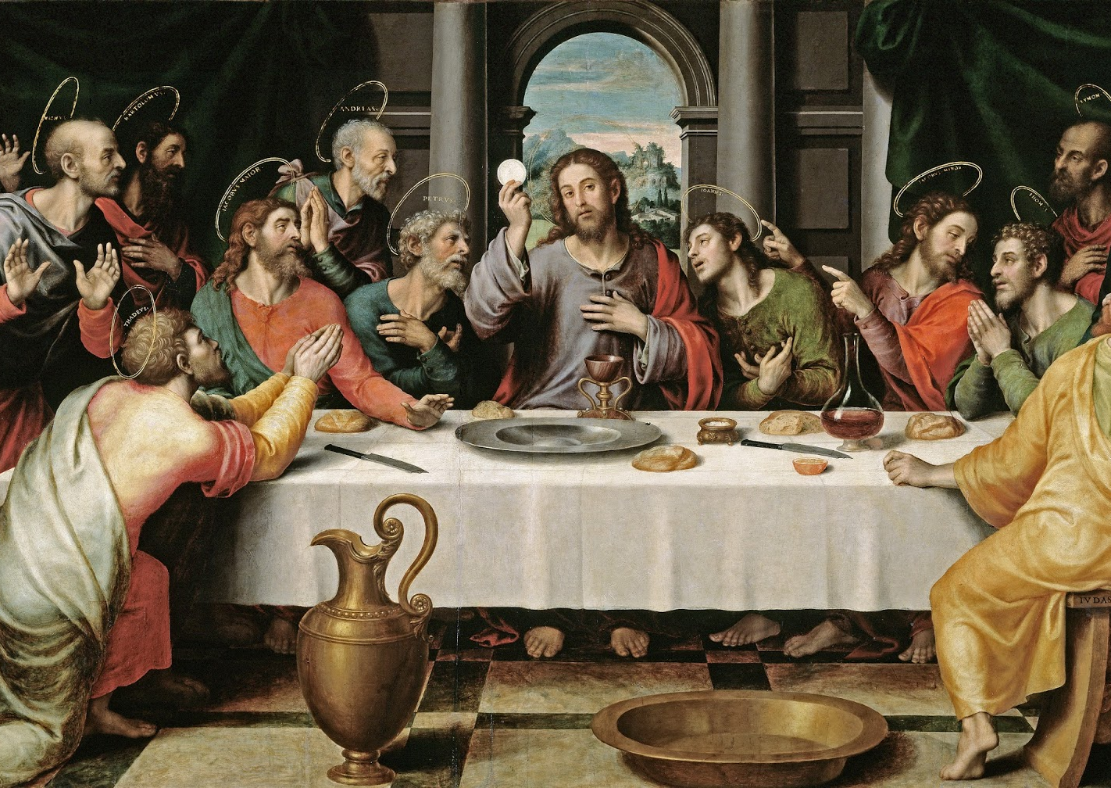
II. 骗子、鱼目混珠者 Deceiver (v 64, 70-71)
犹大没有离开
后来出卖背叛

Slide 8
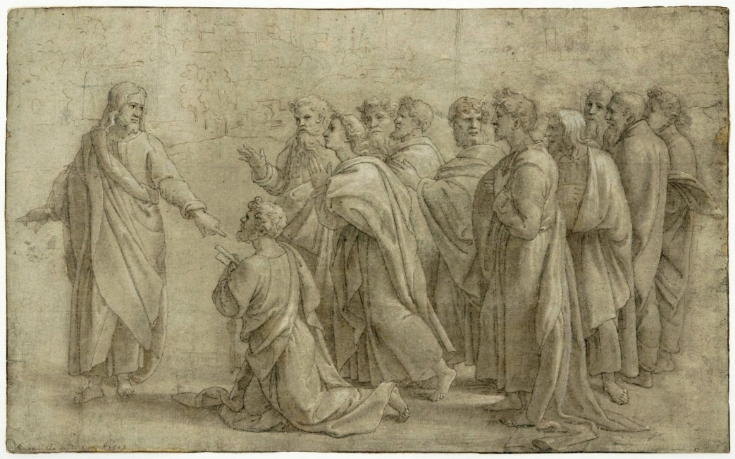
二。坚定跟随者 Determination (v 67-69)
Lord, to whom shall we go?
You have the words of eternal life.
We believe and know that you are the Holy one of God.

Slide 9
What Decision Do You Make?
Receive or Reject?
Follow the crowd or Jesus?
Defection or Determination?

Slide 10
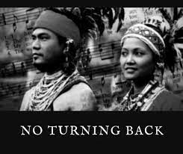
Do you know the story behind the song “I have decided to follow Jesus”?
19 century
a Garo man
Meghalaya tribe
Assam , Indian
“I Have Decided to Follow Jesus”
“Though no one joins me,
still I will follow.”

Slide 11
播放视频到 2’40”
https://www.youtube.com/watch?v=S-h5yZighZU

